Slide 1
Gardens of Mercy
Muslim Cemetery for Devon and Cornwall
A Sacred Natural Burial Ground
Gardens of Mercy.
A Muslim Cemetery for Devon and Cornwall
Green Natural Burial Ground

Slide 2
Google Overview of our land location.

Slide 3
Plots 1,2 and 3

Slide 4
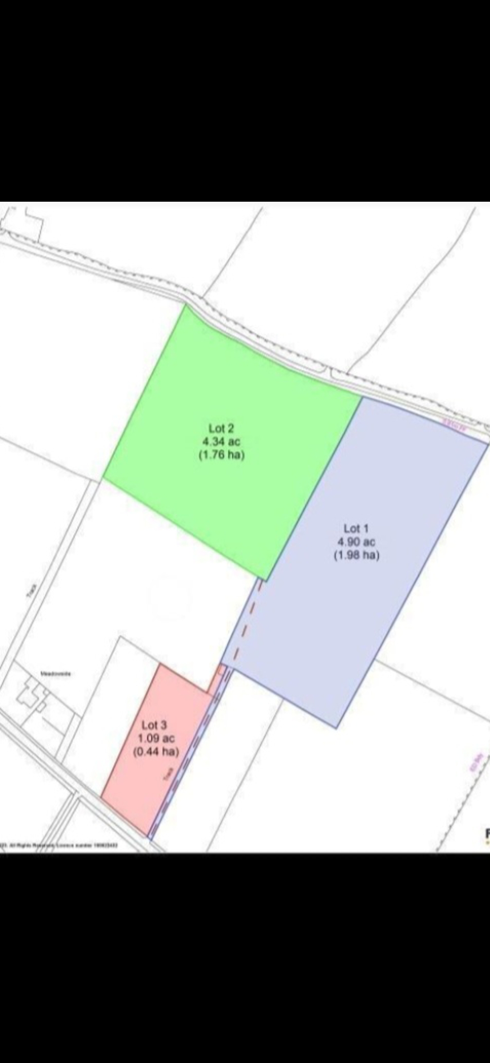
Plots 1,2 and 3

Slide 5
Physical location

Slide 6
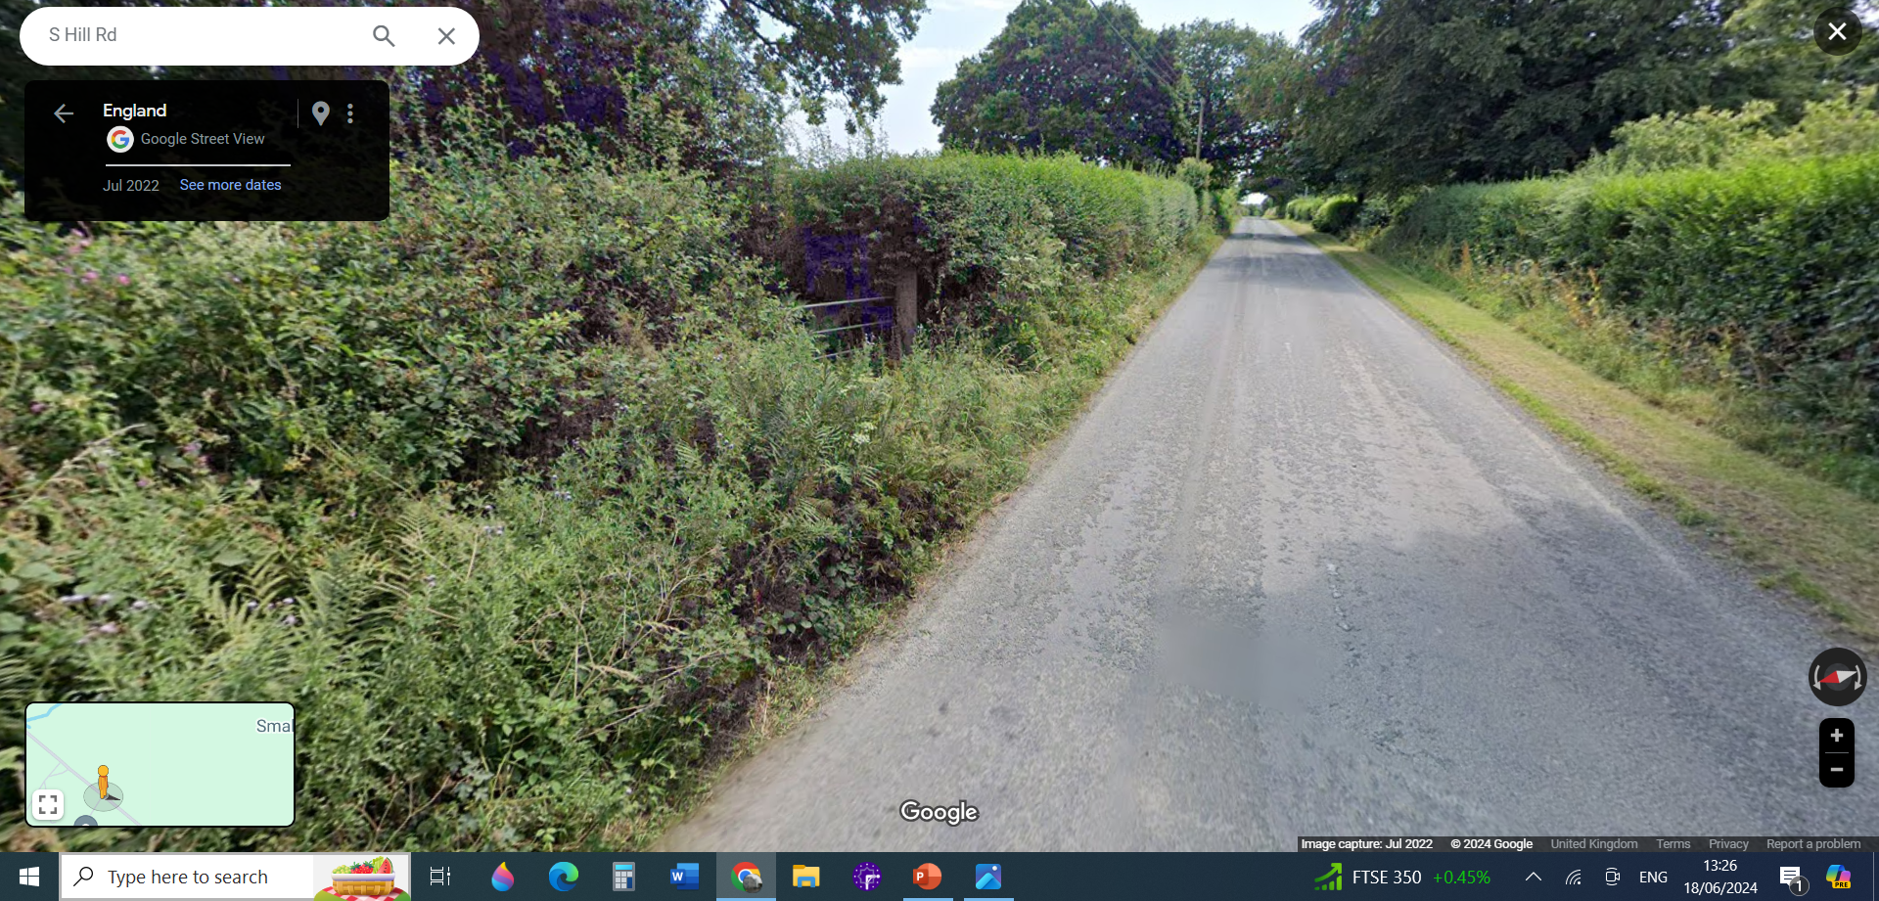
Second View

Slide 7
Overview
• 10.34 acres to be consecrated as per Islamic tradition
10 burials annually
• Provision of burial place for >200 years
• First row of burials will commence at the North border of property
• The acre plot adjacent to South Hill Road will not be used for burials
• Used partly for parking – Road parking not allowed
• The remaining space in this plot and about 75% of the land will be used to
improve on the biodiversity.

Slide 8
Overview continued:
• Emulate Pentiddy Natural Burial Ground in Pensilva.
Despite opposition from some neighbours, planning permission was granted to Anthony. He now says that neighbours are extremely happy with the improvement Pentiddy has done for the environment. We endeavour to achieve the same response from our neighbours
• Planting of Native trees, hedges and wildflower meadow as in Pentiddy
• No tombs or construction at the grave site will be permitted
• Only flat stone name plates (Or other environmentally friendly options)
• Pond to encourage wildlife and act as a soak pit to hold excess water

Slide 9
Need for this project
• To conform to our Islamic traditions and adhere to all
government/local authority requirements
• GoM’s objective: To provide this service locally to the Muslims
and those who adhere to our principles
• Nearest Islamic cemetery is North of Bristol (Near Itchington)
• To reduce cost for the Muslim community to under £2000
(Pentiddy – under £1000)
• Current cost of burial – Just under £6000

Slide 10
So what next?
Consultation with various stakeholders including:
Presentation of our plans to our neighbours in Callington (Meeting on 11th, 18th and 25th June 2024)
Emulating Neighbouring cemeteries operating on the same system as ours, like Pentiddy,
Nationwide cemeteries like the Association of Natural Burial Grounds (Rosie Inman-Cook), Garden of Peace in London, Bristol Muslim Burial, etc
Applied for membership: Asst’n of Natural burial Grounds

Slide 11
Consultations With Our Neighbours 11/06/2024
I must admit, was not the easiest as some attendees were at the verge of making racist statements like:
1- you lot are not good people to be neighbours
2- I worked in the middle east for sometime and I wouldn’t be
happy for you to be my neighbours
3- You do not integrate, you want to enforce your culture on us
4. It will never happen in our neighbourhood, I will fight it all
the way. Not in my backyard
5- You’re just hiding behind this but you’re planning a big thing
(Mosque with minarets),
6- Our Houses are going to loose value
Etc
However,
Many of the concerns, we are happy to address before we submit our application, such as:
1- Plans are too glossy for our neighbourhood,
2- Flood water will increase
3- Traffic will increase, it is already bad enough
4- Providing burial space for other communities
Most Importantly we’ve have had plenty of encouragements

Slide 12
So what next?
Commissioned Various surveys to establish whether the land is viable for our project:
Environmental Survey – already out: Nothing major is highlighted, made recommendations which we are including in our plans,
Archaeological survey: Cornwall Interactive archaeological map, indicates that there is no archaeological interests on site (land)
Water Survey -DEFRA shows that there is no ground water used for human consumption from our site (land)
Highways Agency: Yet to come in
Tier1 Risk assessment for cemeteries: Commissioned but not yet out
We are happy to commission any other survey that will be deemed necessary.

Slide 13
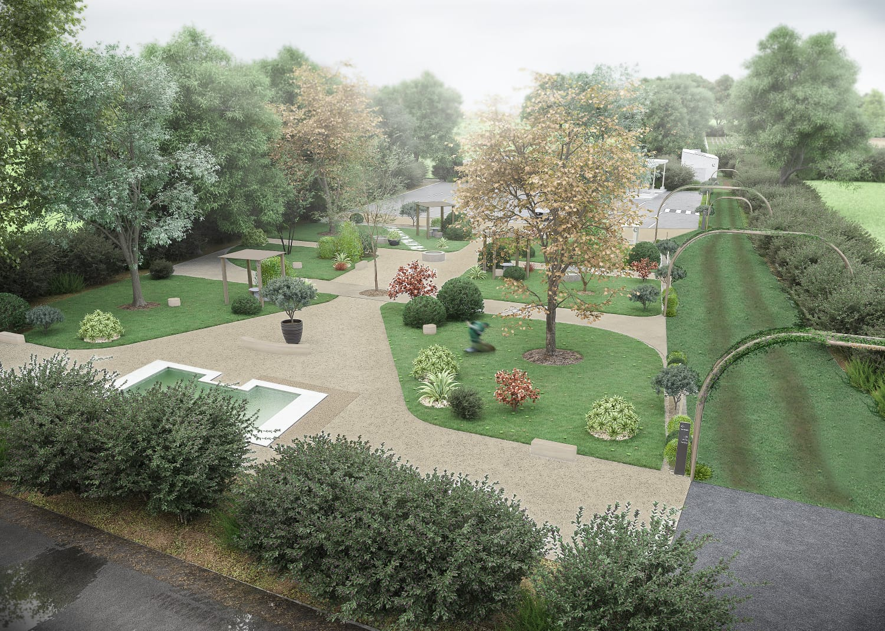

Slide 14
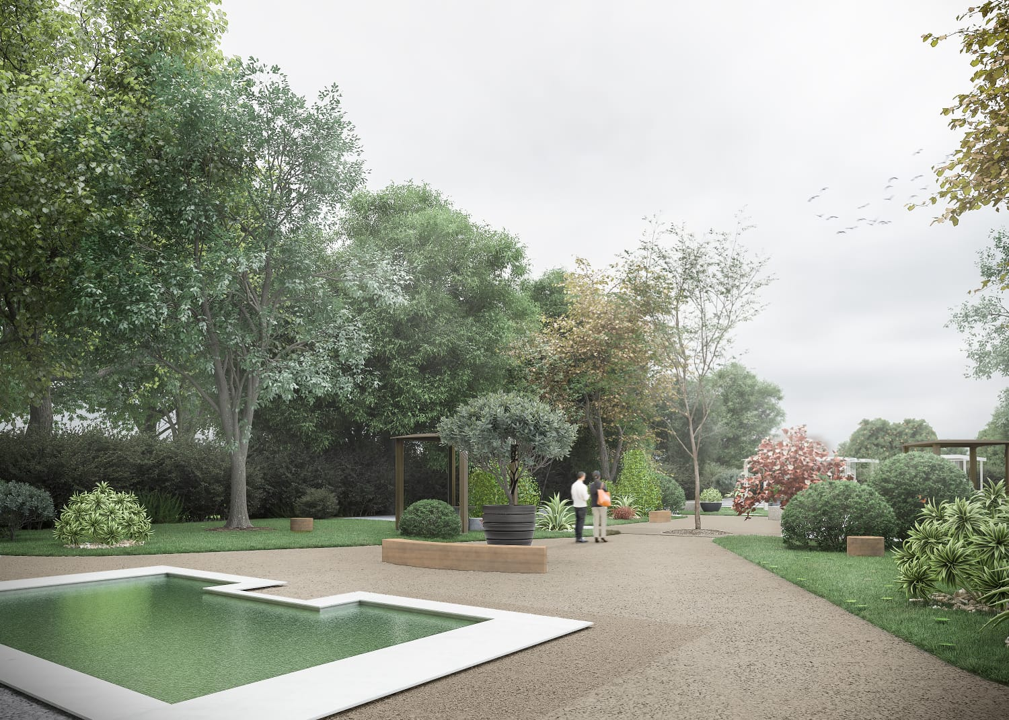

Slide 15
Extra Space not used for burial- Almost 75% of Plot 1 & 2

Slide 16
Burial area starting at North end

Slide 18
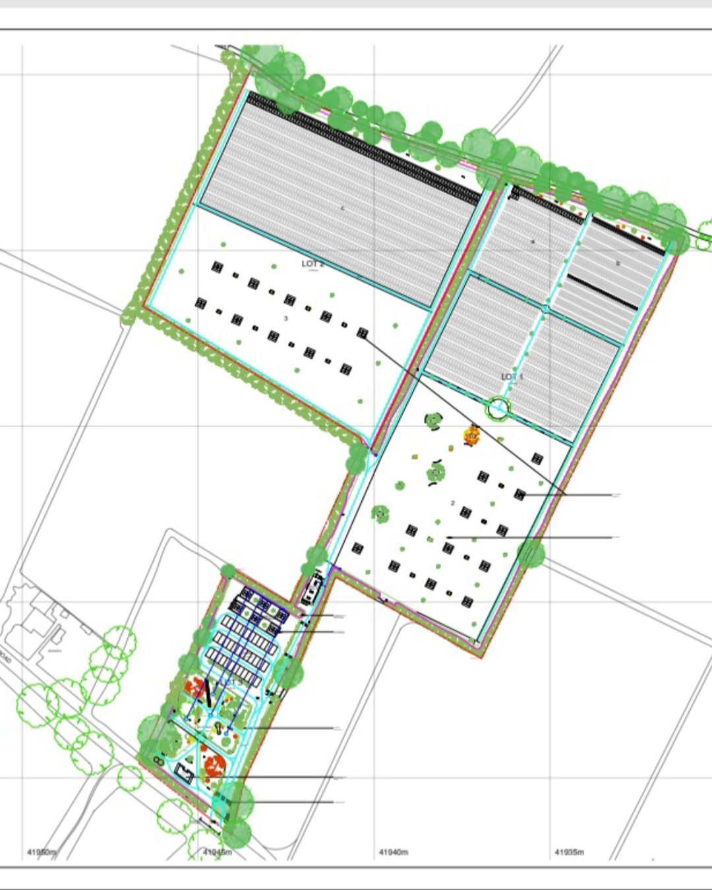

Slide 20
Thanks for listening.
We are happy to take any questions.

