Slide 1
Gardens of Mercy
Muslim Cemetery for Devon and Cornwall
A Sacred Natural Burial Ground
Gardens of Mercy.
A Muslim Cemetery for Devon and Cornwall
Green Natural Burial Ground

Slide 2
Google Overview of our land location.

Slide 3
Plots 1,2 and 3

Slide 4
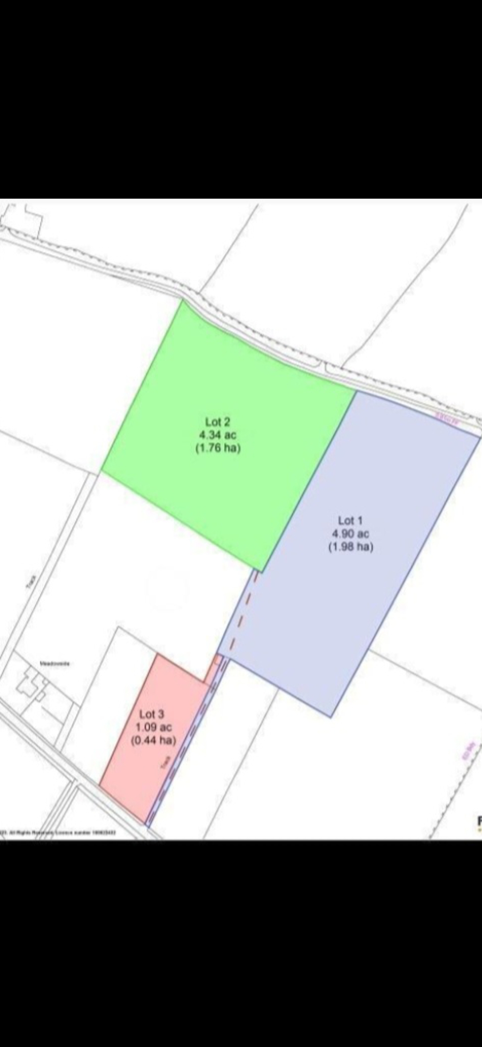
Plots 1,2 and 3

Slide 5
Physical location

Slide 6
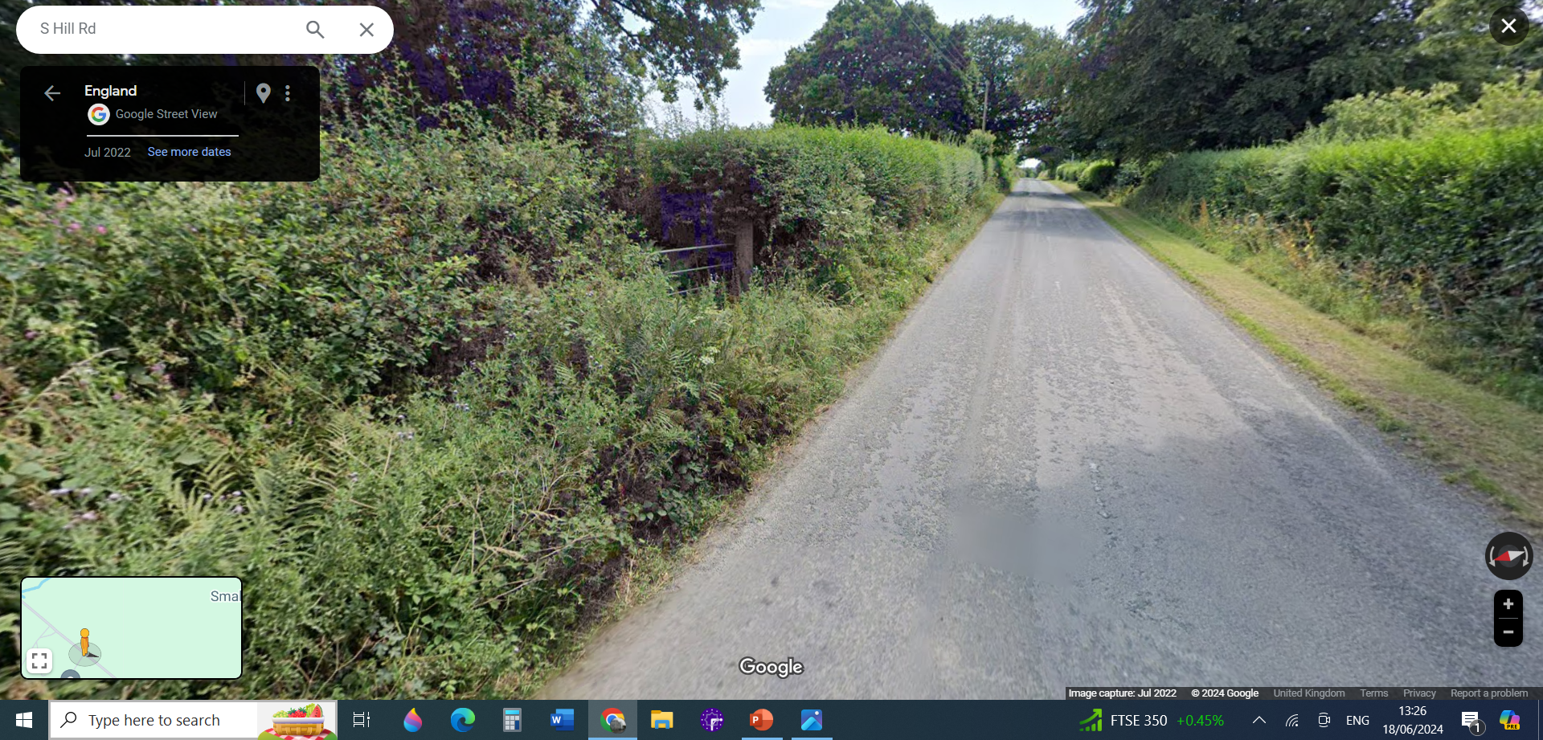
Second View

Slide 7
Overview
• 10.34 acres to be consecrated as per Islamic tradition
About 10 burials annually
• Provision of burial place for >200 years
• First row of burials will commence at the North border of property
• The acre plot adjacent to South Hill Road will not be used for burials
• Used partly for parking – Road parking not allowed
• The remaining space in this plot and about 75% of the land will be used to
improve on the biodiversity.

Slide 8
Overview continued:
• Emulate Pentiddy Natural Burial Ground in Pensilva.
Despite apprehensions expressed by neighbours before planning approval of Pentiddy it now appears that they area very happy with the enhancement in the environment created by Pentiddy. We endeavour to achieve a similar outcome.
• Planting of Native trees, hedges and wildflower meadow as in Pentiddy
• No tombs or construction at the grave site will be permitted
• Only flat laid stone name plates (Or other environmentally friendly options)
• Large retention pond to hold rain water and encourage wild life.

Slide 9
Need for this project
• To conform to our Islamic traditions and adhere to all
government/local authority requirements
• GoM’s objective: To provide this service locally to the Muslims
and those who adhere to our principles
• Nearest Islamic cemetery is North of Bristol (Near Itchington)
All other members of the society have options but nothing for us
• To reduce cost for the Muslim community to under £2000
(Pentiddy – under £1000)
• Current cost of burial – Just under £6000

Slide 10
So what next?
Consultation with various stakeholders including:
Presentation of our plans to our neighbours in Callington (Meeting on 11th, 18th and 25th June 2024)
Emulating Neighbouring cemeteries operating on the same system as ours, like Pentiddy,
Following Nationwide precedents on Muslim and Green cemeteries (ANBG-Rosie Inman-Cook, Garden of Peace in London, Bristol Muslim Burial, Walk Farm Cemetery, etc.
We’re now full members of the Asst’n of Natural burial Grounds, so will be following their code of Conduct

Slide 11
Consultations With Our Neighbours
I must admit, these consultations have not the easiest as some attendees were at the verge of making racist statements like:
1- you lot are not good people to be neighbours
2- I worked in the middle east for sometime and I wouldn’t be
happy for you to be my neighbours
3- You do not integrate, you want to enforce your culture on us
4. It will never happen in our neighbourhood, I will fight it all
the way. Not in my backyard
5- You’re just hiding behind this but you’re planning a big thing
(Mosque with minarets),
6- Our Houses are going to loose value

Slide 12
Consultations With Our Neighbours
However, their concerns have been taken on board and will be addressed before we submit our application, such as:
1- Plans are too glossy for our neighbourhood,
2- Flood water will increase
3- Traffic will increase, it is already bad enough
4- Providing burial space for other communities
Most Importantly we have had plenty of encouragements as well.

Slide 13
So what next?
Commissioned Various surveys to establish whether the land is viable for our project:
Environmental Survey – already out: Nothing major is highlighted, made recommendations which we are including in our plans,
Archaeological survey: Cornwall Interactive archaeological map, indicates that there is no archaeological interests on site (land)
Water Survey -DEFRA shows that there is no ground water used for human consumption from our site (land)
Highways Agency: Yet to come in
Tier1 Risk assessment for cemeteries: No site specific concerns raised.
We are happy to commission any other survey that will be deemed necessary.

Slide 14
OVERHEAD VIEW OF THE SITE FROM THE MAIN ROAD

Slide 15
Burial area starting at North end

Slide 16
THE ONLY PROPOSED BUILDING ON SITE- Redevelopment of existing shed

Slide 17
Parking Green area

Slide 19
Thanks for listening.
We are happy to take any questions.

